Slide 1
TUTORKEY: AN ONLINE TUTOR FINDER APP
By, SAFWA NIZAMUDEEN Guide: Prof.SHEERA SHAMSU
Roll No: MCA23-153

Slide 2
OVERVIEW
TutorKey is a digital platform designed to bridge the gap between learners and private tutors, facilitating an efficient tutoring experience. The application aims to empower students by providing them access to qualified tutors across various subjects, promoting academic growth and enhancing lifelong learning opportunities.

Slide 3
PROBLEM STATEMENT
●Difficulty in finding tutors.
●Parents and students may have concerns about the credibility and qualifications of tutors.
● Coordinating schedules between tutors and learners can be difficult, leading to missed sessions.
●Learners face challenges in locating tutors who match their subject needs and skill level, often lacking a centralized platform to compare tutor options effectively.

Slide 4
TOOLS USED
Flutter & Dart: Framework and programming language used to build a cross-platform mobile app with a smooth, responsive UI for both Android and iOS.
Firebase Authentication & Firestore: For secure user authentication, real-time data synchronization, and backend data storage, ensuring a reliable and seamless experience

Slide 5
EXISTING SYSTEM
Traditional methods involve searching for tutors through word of mouth, local ads, or separate websites, which can be time-consuming and unreliable.
Often, the available information about tutors is limited to basic details, with no centralized profile showcasing qualifications, subjects, or availability.
Most existing systems don’t offer real-time booking or scheduling tools, leading to frequent coordination issues and missed sessions.

Slide 6
PROPOSED SYSTEM
Users can register or log in, selecting their role as either a "Tutee" or a "Tutor" to personalize their experience.
Tutors can create detailed profiles with information on their qualifications, subjects taught, and experience. This helps learners get an overview of each tutor's expertise.
Learners can search tutors based on specific subjects, helping them quickly find a tutor for the desired topic.
Tutors can set available slots for sessions, which learners can view before booking.

Slide 7
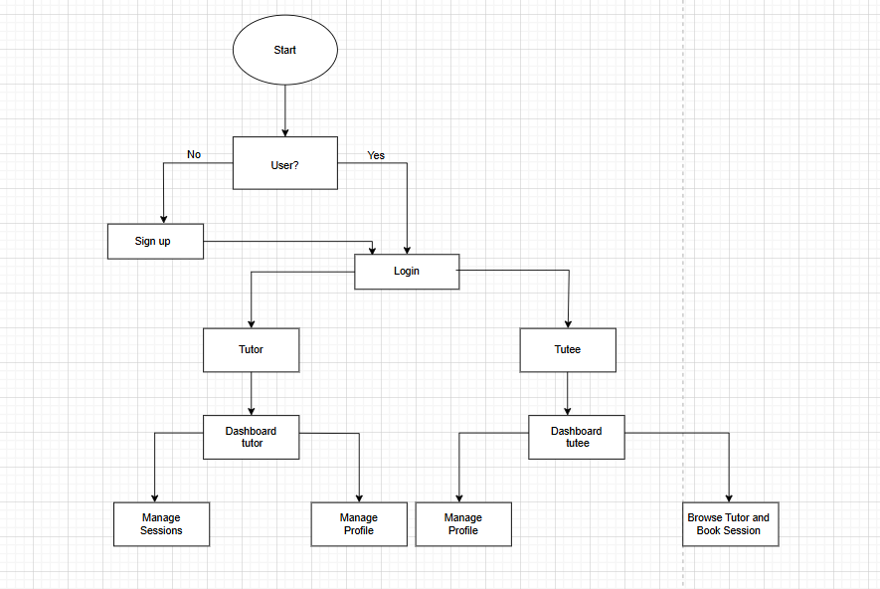
BLOCK DIAGRAM

Slide 8
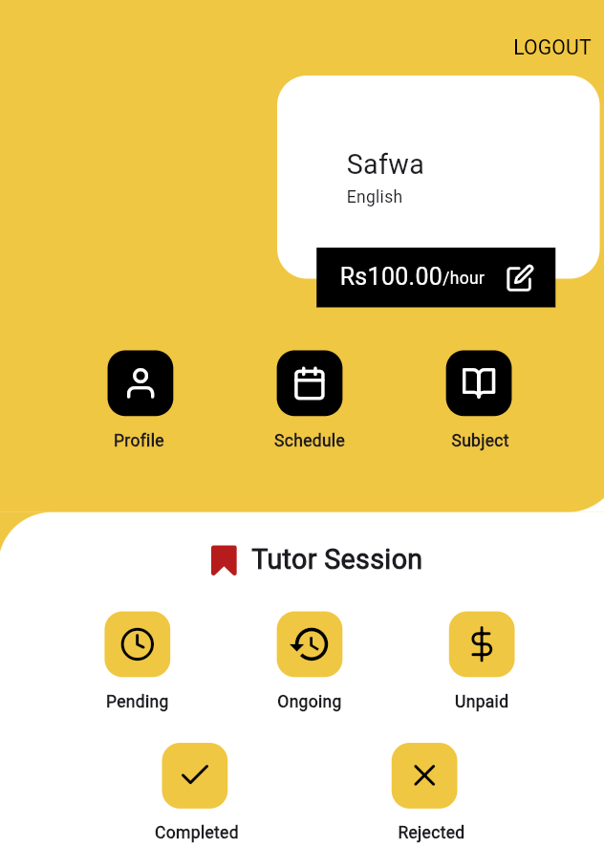
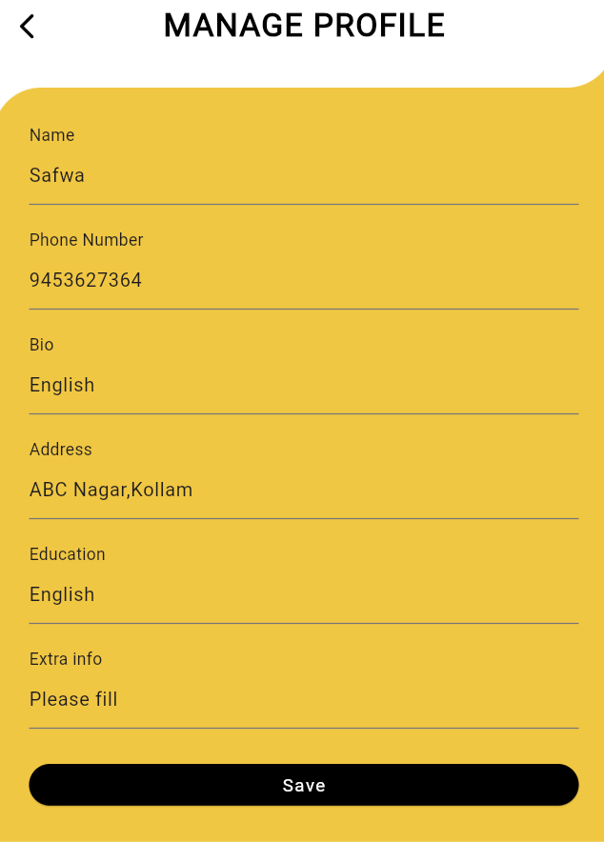

OUTPUT

Slide 9
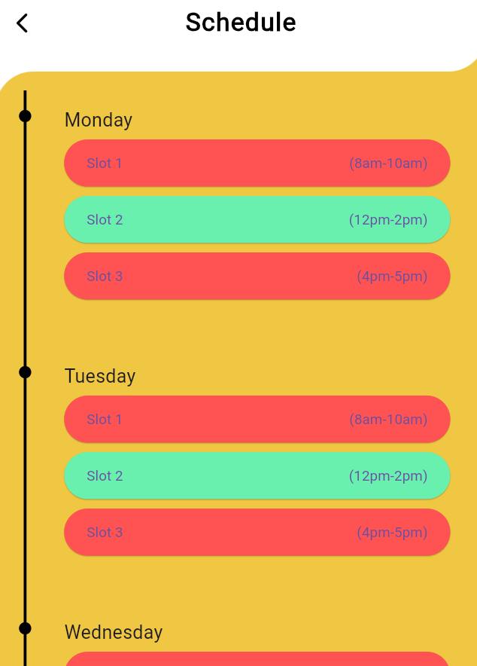
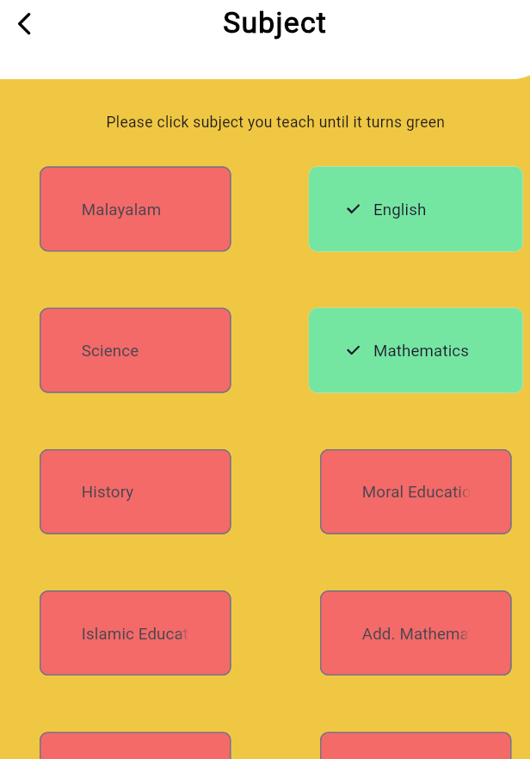
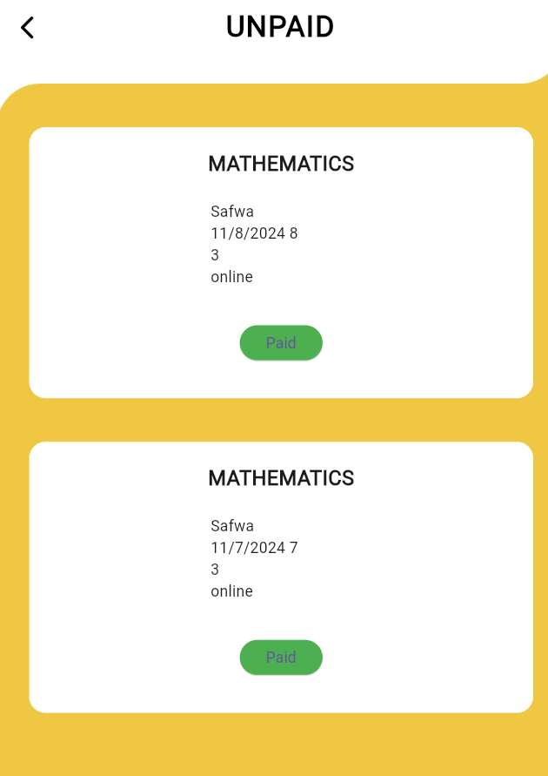

Slide 10
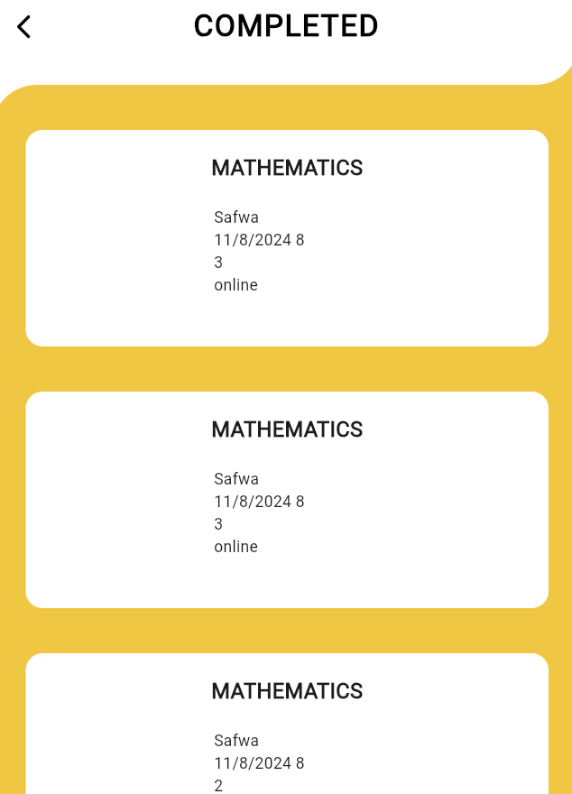
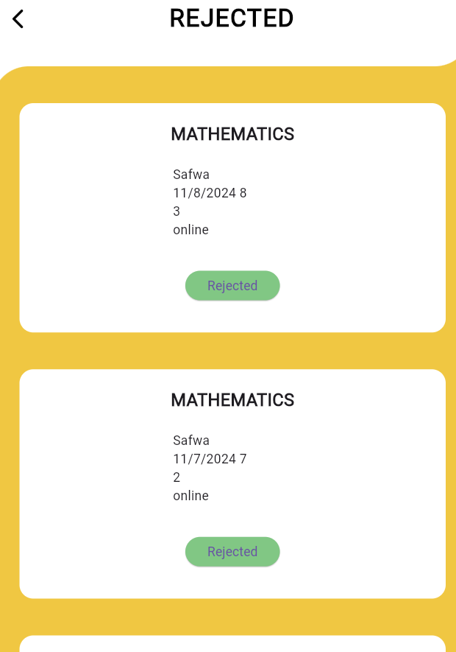
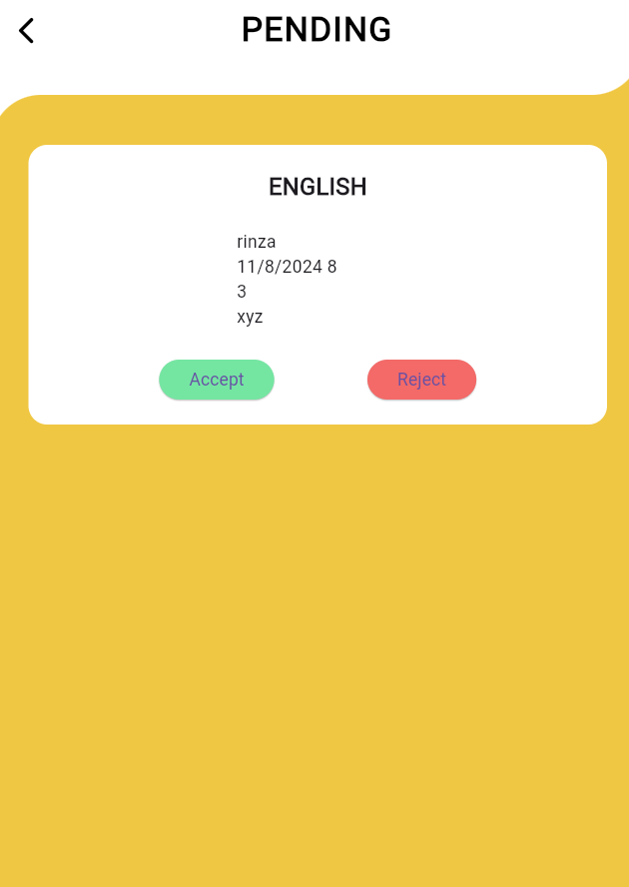

Slide 11
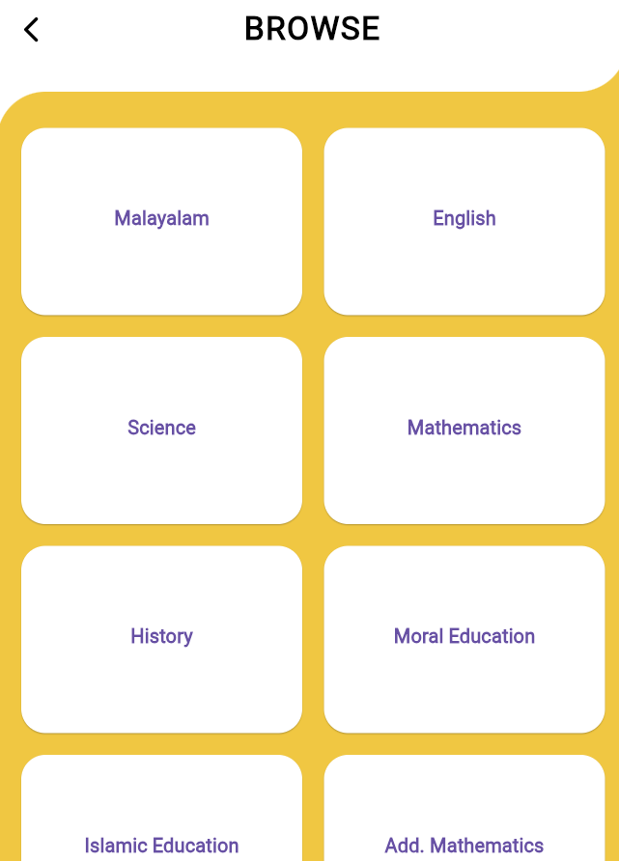
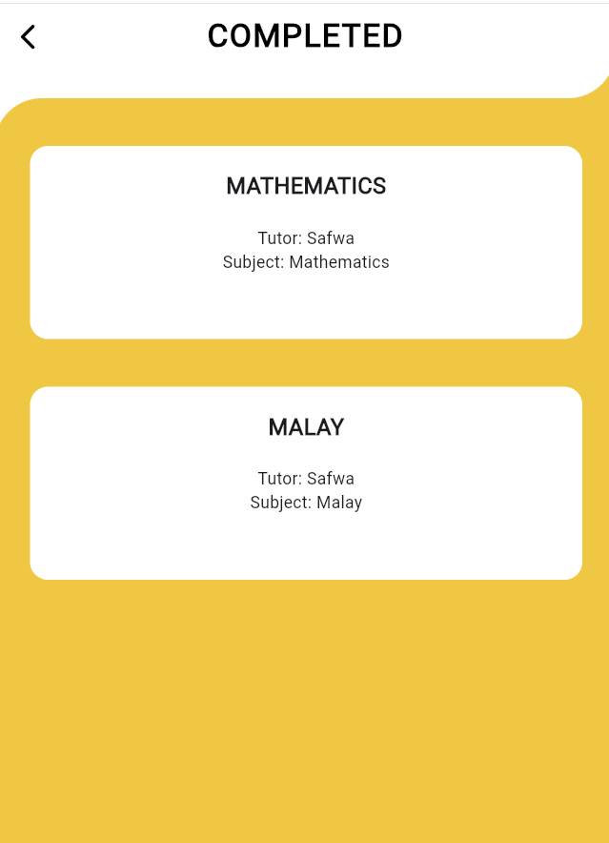
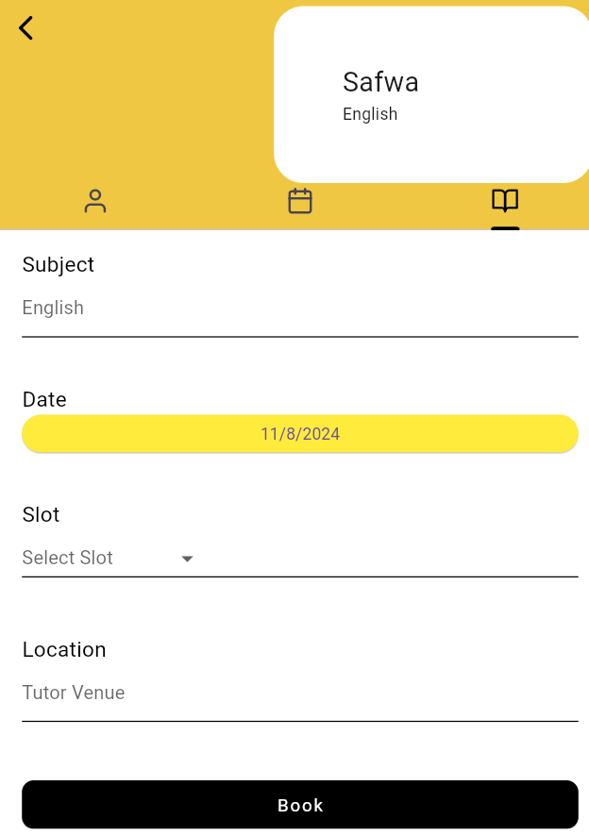

Slide 12
Future Enhancement
Integrate secure payment gateways (e.g., Stripe, PayPal) for managing payments directly within the app, streamlining the process for users.
Introduce ratings and reviews to help learners make informed choices based on tutor performance and feedback from previous students.
Add in-app video calling for virtual tutoring sessions, improving convenience for both learners and tutors.
Add GPS or location services to match learners with nearby tutors for in-person sessions if desired.

Slide 13
References
Alexandria M. Gonzales, Kristine Ane O. Beringuela, Danice Ann S. Rudio, Jan Andrei S. Cantalejo, Reycel I. Bautista, Cris Norman P. Olipas ,and Andrew Caezar A. Villegas , ”Project Learn: The Development and Assessment of a Cross-Platform Tutor Finder “ , College of Information and Communications Technology, Nueva Ecija University of Science and Technology, Philippines,2023

